Slide 1
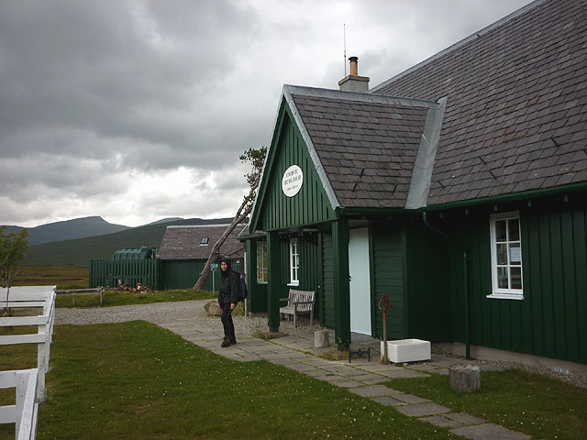

MESS MANAGEMENT SYSTEM
TEAM 8

Slide 2

Agenda
Introduction
Feasibility Study & Requirement Analysis
Problem Statement
Relationship and Participation Constraint
Table Description
ER Diagram
Schema Diagram
Normalization
Conclusion

Slide 3


Introduction
The Mess Management System helps the user to access all the functionalities of the mess without having to visit the mess physically and to apply for leave. It enables the admin/owner to view the inventory and access customer and mess staff details.
The main aim behind this presentation is to get the current status of mess & meals per day, to manage details regarding the stocks of meals, customers availing the meal services and also the info about the mess staffs.
Using the information provided by all the mess management database, the admin can take decisions and the inventory for total mess can be managed efficiently.

Slide 4

FEASIBILITY STUDY
Yes, it is technically feasible to design such a system. There are
technology available which can be used to easily design Mess Management system. The data storage capability of our system is large
i.e., it can store data without running out of space for many years to
come. This system is very responsive, and the servers can be used to
fetch data wherever you are in the world. The data required will be
instantly delivered without any delay. It is a very reliable system and
a very safe system where data security is of utmost importance.
Our system is also economically feasible. It can be installed easily
and the cost of implementing is not that high. The benefit of once
implementing this system is immense and will be beneficial for
coming number of years.

Slide 5
REQUIREMENT ANALYSIS
Usability Requirement: The website is designed for user friendly environment and ease of use.
Database Security: Unauthorized person cannot access the panel and database, do not read and write the information.
Reliability Requirement: The system provides a reliable environment for teachers. All requirements are reaching at the admin without any errors.

Slide 6
Problem Statement
A Mess Manager can supervise the information of multiple mess staffs.
Different types of Meals are decided by the individual Mess Staff. There is an Entity Meal which have some attributes as Item No., Item Name, Complimentary food along with the timings of the meals for breakfast, lunch, and dinner.
A type of meal is selected/ chosen by a mess member in the mess.
Then the member must pay the bill for the respective month after he finishes his completion of every month in the mess. Bill details such as Date, Time, Month, Due Amount, Payment done is saved in saved in the mess database.
Any member of mess can complain about the mess staff in case of bad meal, improper timing of meal or in case of bad behaviour of the mess Staff member.
Feedback is given by the members of mess for the mess service of meals, meal quality rating, behaviour of staff and so on. Feedback details is stored according to following date, time and rating of the food.
According to Feedback received the mess manages the meal based on improving meal rating, timing, etc.
Mess members stays in the room of the hostel. Allotment is done based on type of room they choose according to that room no is provided to the mess member.

Slide 7
Relationship and Participation Constraint
Relationship (N :1), Recursive Relationship both full participations.
Relationship (1: N), Meal is total and Manager is partial participation. There is an Entity Meal which have some attributes as Item No., Item Name, Complimentary food, along with the timings of the meals for breakfast, lunch, and dinner.
Relationship (1: N) meal partial and mess member partial.
Relationship (1:1) both are Total participation. Bill details such as Date, Time, Month, Due Amount, Payment done is saved in saved in the mess database.
Relationship (M:N) partial participation.
Feedback details is stored according to following date, time and rating of the food. Relationship (1: 1) full participation.
Relationship (M: N). Feedback is Total participation and Meal is partial participation.
Relationship (M: 1). Mess Member and Room are both total participation.

Slide 8
LIST OF ENTITIES
Entities | Attributes
1. Mess Staff | Eno (PK) Name Gender Address D.O.J [Date of Joining] Salary Mob_No (Multivalued Attribute)
2. Mess Member | MemberID (PK) Name Gender Address Mob_No (Multivalued Attribute) D.O.J.
3. Meal | Item No (PK) Item Name Complementary Food (Multivalued) Meal Type
4. Bill | Bill No (PK) Date Month Payment Status Dues Amount
5. Feedback (Weak Entity) | Fno (Partial key) Date Rating
6. Room (Weak Entity) | Room_No (Partial Key) Room Type

Slide 9
Table Description
Mess_Member
Mess_Staff
Field | Datatype | Length | Constraints
Member_ID | Number | 5 | Primary Key
Name | Varchar2 | 20
Gender | Varchar2 | 7
Address | Varchar2 | 30
D.O.J. (Date Of Joining) | Date
Field | Datatype | Length | Constraints
Eno | Number | 5 | Primary Key
Name | Varchar2 | 20
Gender | Varchar2 | 7
Address | Varchar2 | 30
D.O.J. | Date
Salary | Number | 8
Mob_No | Number | 10
Meal
Field | Datatype | Length | Constraints
Item_No | Number | 2 | Primary Key
Item Name | Varchar2 | 20
Meal Type | Varchar2 | 15
MemberId | Number | 5 | Foreign Key
Room
Field | Datatype | Length | Constraints
Room_No | Number | 4 | Partial Key
Member_Id | Number | 5 | Foreign Key
Room Type | Varchar2 | 5
Meal_Complementary_Food
Field | Datatype | Length | Constraints
COMPLEMENTARY_FOOD | Number | 10 | Primary Key
ITEM_NO | Number | 2 | Foreign Key

Slide 10
Table Description
Bill
Changes
Field | Datatype | Length | Constraints
Bill_No | Number | 5 | Primary Key
Date1 | date
Month | Varchar2 | 15
Payment Status | Varchar2 | 8
Dues Amount | Number | 8
Field | Datatype | Length | Constraints
Item_No | Number | 2 | Primary Key
FNO | Number | 5 | Foreign Key
MemberId | Number | 5 | Foreign Key
Mess_Member_Mobile_No
Field | Datatype | Length | Constraints
MOBILE_NO | Number | 10 | Primary Key
MemberId | Number | 5 | Foreign Key
Feedback
Field | Datatype | Length | Constraints
Fno | Number | 5 | Primary Key
Date | Date
Rating | Number | 2
Mess_Staff_MobNo
Field | Datatype | Length | Constraints
MOBILE_NO | Number | 10 | Primary Key
ENo | Number | 5 | Foreign Key

Slide 11
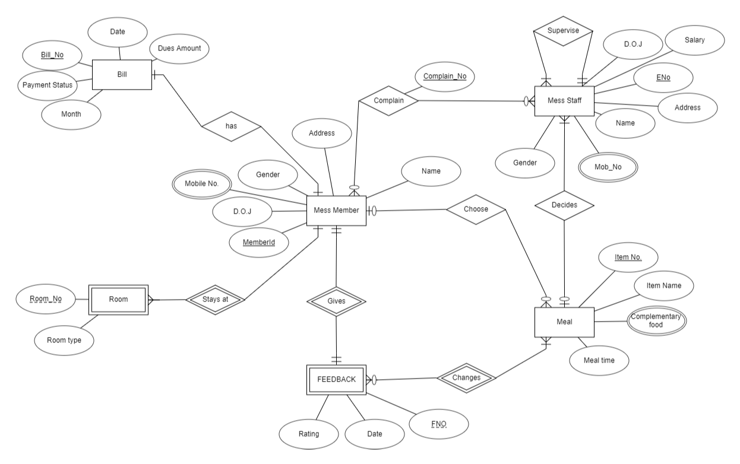
ER Diagram

Slide 12
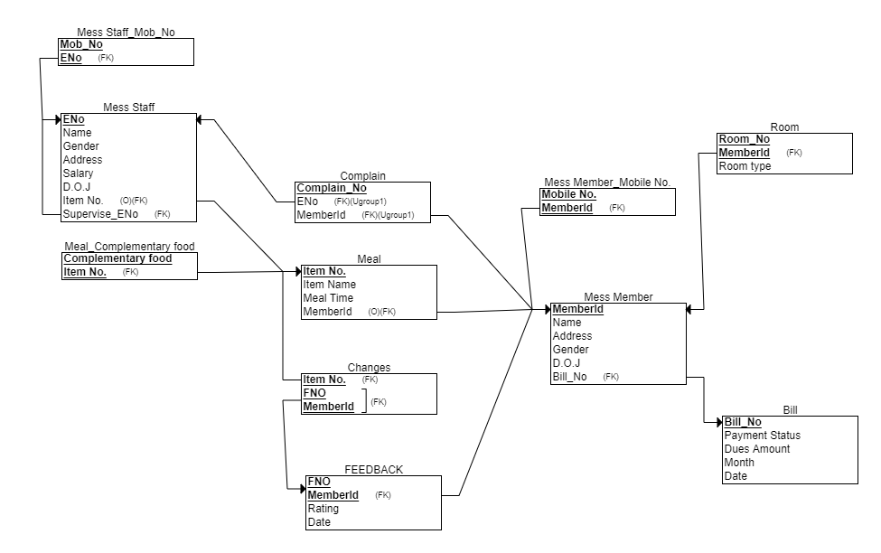
Schema Diagram

Slide 13
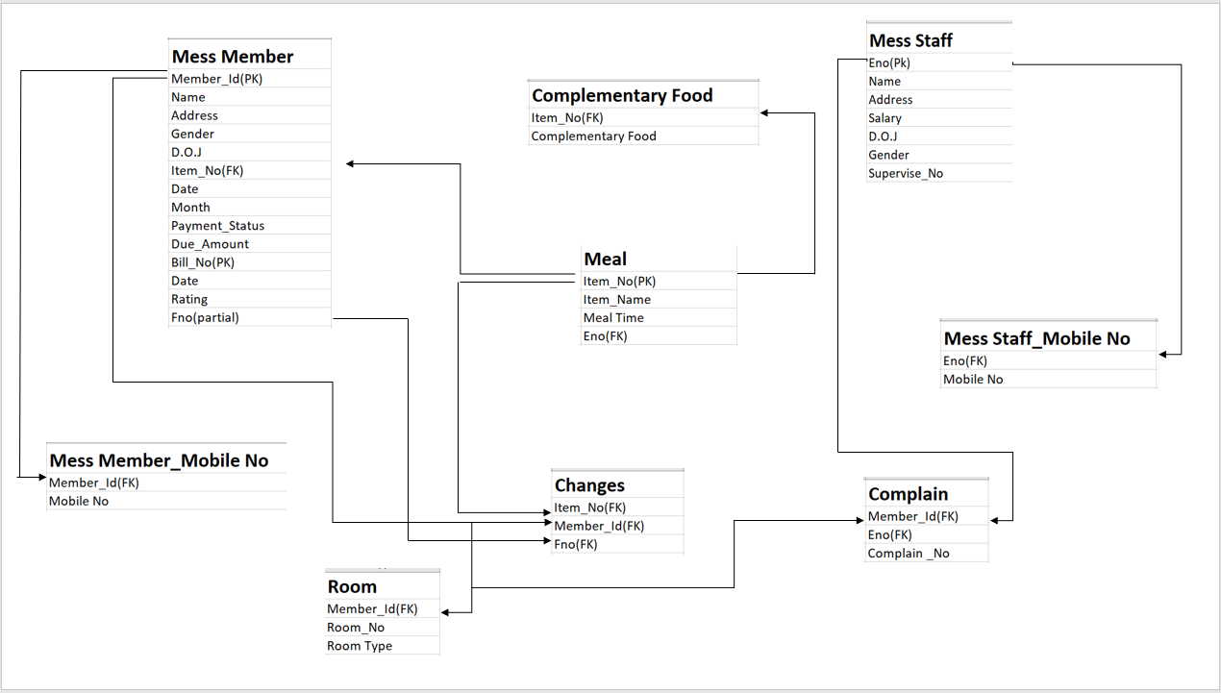
Schema Diagram

Slide 14
Normalization
Normalization is the process of minimizing redundancy from a relation or set of relations. Redundancy in relation may cause insertion, deletion, and update anomalies. So, it helps to minimize the redundancy in relations. Normal forms are used to eliminate or reduce redundancy in database tables.
First Normal Form
A relation is in first normal form if every attribute in that relation is singled valued attribute. (or)
A relation schema R is in 1NF, if it does not have any composite attributes, multivalued attribute or their combination.

Slide 15
Mess_Member_Mobile_No
Member_ID | Mob_No
22001 | 7895236475, 7008389689
22002 | 9955400877
22003 | 7488192958
22004 | 9861775097
22005 | 9931436435, 8114755079
Table Mess_Member_Mobile_No is not in 1NF because of mutivalued attributes of Mob_No. To make it into 1NF, we decomposed the table as follows:
Member_ID | Mob_No
22001 | 7895236475
22001 | 7008389689
22002 | 9955400877
22003 | 7488192958
22004 | 9861775097
22005 | 9931436435
22005 | 8114755079
Mess_Member_Mobile_No

Slide 16
Mess_Staff_Mob_No
ENO | Mob_No
10001 | 8114755079
20010 | 9931436478
20011 | 9861954758
20012 | 8956742314
20013 | 7005968541, 9866564721
Table Mess_Staff_Mob_No is not in 1NF because of multivalued attributes of Mob_No. To make it into 1NF, we decomposed the table as follows:
Mess_Staff_Mob_No
ENO | Mob_No
10001 | 8114755079
20010 | 9931436478
20011 | 9861954758
20012 | 8956742314
20013 | 7005968541
20013 | 9866564721

Slide 17



Conclusion
We have successfully presented case study based on Mess Management System. During the development of this project, we first analysed how feasible this system is and what are its requirements. Then we created the table with all the constraints and restrictions.
With keeping view of the table description, we created the ER diagram and how various entities are related to each other. Then we show the schema diagram and how primary key and foreign key are related in each schema. Then we created the normalised forms of the table and completely removed the redundancy of the data and complexity of relations in the system.
With the help of ER- Diagram we create a fully functional system for the Mess Management. Creating it with the help of ER model will help us to fully implement in the back end of the system. This will hold of all the data that’ll enter and exit the system. And there won’t be any redundancy or inconsistency of data. All the relations are designed with keeping in view of the various relational protocols.

Slide 18

THANK YOU

